Slide 1
Introduction to Programming
Session 03
Condition Statements

Slide 2
Objectives
Expressions
Operators
Type Casting
If statement
If-else statement
if-else-if ladder
nested if statement
Switch statement

Slide 3
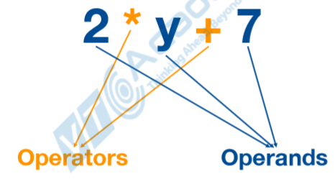
Expressions
Expression is a combination of operators and operands
Example:

Slide 4
Operators
Operator in java is a symbol that is used to perform operations. There are many types of operators in java which are given below:
  Unary Operator,
  Arithmetic Operator,
  Shift Operator,
  Relational Operator,
  Bitwise Operator,
  Logical Operator,
  Ternary Operator and
  Assignment Operator.

Slide 5
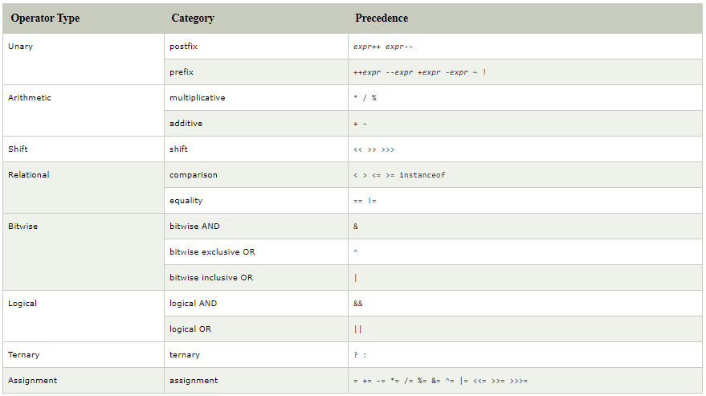
Operators

Slide 6
Operators
Operator in java is a symbol that is used to perform operations. There are many types of operators in java which are given below:
  Unary Operator,
  Arithmetic Operator,
  Shift Operator,
  Relational Operator,
  Bitwise Operator,
  Logical Operator,
  Ternary Operator and
  Assignment Operator.

Slide 7
Java Unary Operator
The Java unary operators require only one operand. Unary operators are used to perform various operations:
  incrementing/decrementing a value by one
  negating an expression
  inverting the value of a boolean
Java Unary Operator Example: ++ and –
Example:
    class OperatorExample{
      public static void main(String args[]){
        int x=10;
        System.out.println(x++);//10 (11)
        System.out.println(++x);//12
        System.out.println(x--);//12 (11)
        System.out.println(--x);//10
      }
    }

Slide 8
Java Arithmetic Operators
Java arithmatic operators are used to perform addition, subtraction, multiplication, and division. They act as basic mathematical operations.
Example:
  class OperatorExample{
    public static void main(String args[]){
      int a=10;
      int b=5;
      System.out.println(a+b);//15
      System.out.println(a-b);//5
      System.out.println(a*b);//50
      System.out.println(a/b);//2
      System.out.println(a%b);//0
    }
  }

Slide 9
Java Logical Operators
Logical && and Bitwise &
  The logical && operator doesn't check second condition if first condition is false. It checks second condition only if first one is true.
  The bitwise & operator always checks both conditions whether first condition is true or false.
Example:
  class OperatorExample{
    public static void main(String args[]){
      int a=10;
      int b=5;
      int c=20;
      System.out.println(a<b&&a++<c);//false && true = false
      System.out.println(a);//10 because second condition is not checked
      System.out.println(a<b&a++<c);//false && true = false
      System.out.println(a);//11 because second condition is checked
  }
  }

Slide 10
Java Logical Operators
Logical || and Bitwise |
  The logical || operator doesn't check second condition if first condition is true. It checks second condition only if first one is false.
  The bitwise | operator always checks both conditions whether first condition is true or false.
Example:
class OperatorExample{
  public static void main(String args[]){
    int a=10;
    int b=5;
    int c=20;
    System.out.println(a>b||a<c);//true || true = true
    System.out.println(a>b|a<c);//true | true = true
    //|| vs |
    System.out.println(a>b||a++<c);//true || true = true
    System.out.println(a);//10 because second condition is not checked
    System.out.println(a>b|a++<c);//true | true = true
    System.out.println(a);//11 because second condition is checked
  }
}

Slide 11
Java Ternary Operator
Java Ternary operator is used as one liner replacement for if-then-else statement and used a lot in java programming. it is the only conditional operator which takes three operands.
Example:
  class OperatorExample{
    public static void main(String args[]){
      int a=2;
      int b=5;
      int min=(a<b)?a:b;
      System.out.println(min); //2
    }
  }

Slide 12
Java Assignment Operator
Java assignment operator is one of the most common operator. It is used to assign the value on its right to the operand on its left.
Example
  class OperatorExample{
    public static void main(String args[]){
      int a=10;
      int b=20;
      a+=4;//a=a+4 (a=10+4)
      b-=4;//b=b-4 (b=20-4)
      System.out.println(a); //14
      System.out.println(b); //16
    }
  }

Slide 13
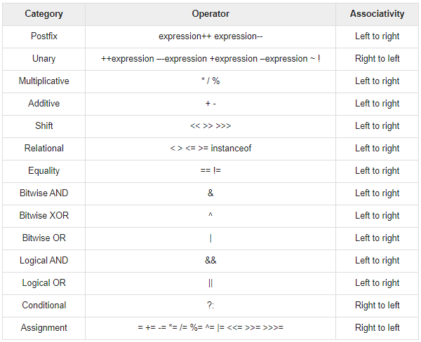
Precedence of Java Operators

Slide 14
Java Type Casting
Type casting is used to convert an object or variable of one type into another. Syntax:
    dataType variableName = (dataType) variableToConvert;
There are two casting directions: narrowing (larger to smaller type) and widening (smaller to larger type).
  Widening Casting (automatically)
    byte -> short -> char -> int -> long -> float -> double
  Narrowing Casting (manually)
    double -> float -> long -> int -> char -> short -> byte

Slide 15
Java Type Casting
Widening Casting: is done automatically when passing a smaller size type to a larger size type:
  public class MyClass {
    public static void main(String[] args) {
      int myInt = 9;
      double myDouble = myInt; // Automatic casting: int to double
      System.out.println(myInt); // Outputs 9
      System.out.println(myDouble); // Outputs 9.0
    }
  }

Slide 16
Java Type Casting
Narrowing Casting: must be done manually by placing the type in parentheses in front of the value:
  public class MyClass {
    public static void main(String[] args) {
      double myDouble = 9.78;
      int myInt = (int) myDouble; // Manual casting: double to int
      System.out.println(myDouble); // Outputs 9.78
      System.out.println(myInt); // Outputs 9
    }
  }

Slide 17
Java If statement
The Java if statement is used to test the condition. It checks boolean condition: true or false.
There are various types of if statement in java:
  if statement
  if-else statement
  if-else-if ladder
  nested if statement

Slide 18
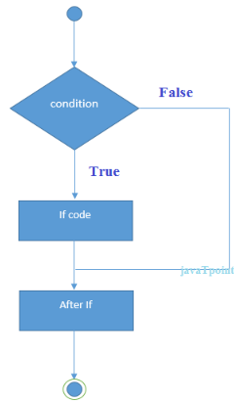
If statement
The Java if statement tests the condition. It executes the if block if condition is true. Syntax:
  if(condition){
  //code to be executed
  }
Example:
  public class IfExample {
    public static void main(String[] args) {
      int age=20;
      if(age>18){
      System.out.print("Age is greater than 18");
      }
    }
  }

Slide 19
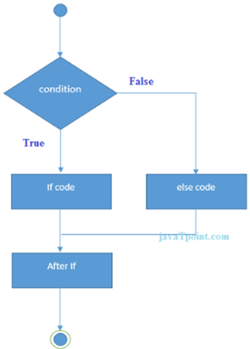
If-else statement
The Java if statement tests the condition. It executes the if block if condition is true. Syntax:
  if(condition){
  //code if condition is true
  }else{
  //code if condition is false
  }
Example:
  public class IfExample {
    public static void main(String[] args) {
      int year=2020;
      if(((year % 4 ==0) && (year % 100 !=0)) || (year % 400==0)){
      System.out.println("LEAP YEAR");
      }
      else{
      System.out.println("COMMON YEAR");
      }
    }
  }

Slide 20
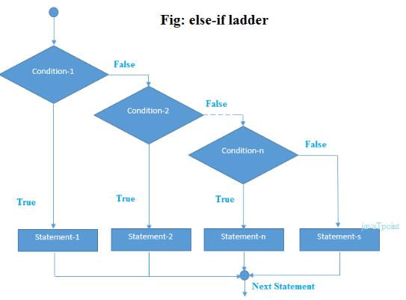
If-else-if ladder
The if-else-if ladder statement executes one condition from multiple statements. Syntax:
if(condition1){
//code to be executed if condition1 is true
}else if(condition2){
//code to be executed if condition2 is true
}
...
else{
//code to be executed if all the conditions are false
}

Slide 21
If-else-if ladder
public class IfElseIfExample {
public static void main(String[] args) {
      int marks=65;
      if(marks<50){ System.out.println("fail"); }
      else if(marks<60){ System.out.println("D grade"); }
      else if(marks<70){ System.out.println("C grade"); }
      else if(marks<80){ System.out.println("B grade"); }
      else if(marks>=80 && marks<90){ System.out.println("A grade"); }
      else if(marks>=90 && marks<100){ System.out.println("A+ grade"); }
      else{ System.out.println("Invalid!"); }
  }
}

Slide 22
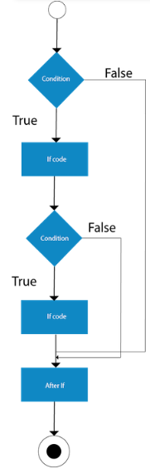
Nested if statement
The nested if statement represents the if block within another if block.Syntax:
  if(condition){
  //code to be executed
  if(condition){
  //code to be executed
  }
  }

Slide 23
Nested if statement
public class JavaNestedIfExample{
  public static void main(String[] args) {
    //Creating two variables for age and weight
    int age=25, weight=48;
    //applying condition on age and weight
    if(age>=18){
      if(weight>50){
      System.out.println("You are eligible to donate blood");
      } else{
      System.out.println("You are not eligible to donate blood");
      }
    } else{
    System.out.println("Age must be greater than 18");
    }
  }
}

Slide 24
Java Switch Statement
The Java switch statement executes one statement from multiple conditions. It is like if-else-if ladder statement. The switch statement works with byte, short, int, long, enum types, String and some wrapper types like Byte, Short, Int, and Long. Since Java 7, you can use strings in the switch statement.
In other words, the switch statement tests the equality of a variable against multiple values.
Points to Remember
  There can be one or N number of case values for a switch expression.
  The case value must be of switch expression type only. The case value must be literal or constant. It doesn't allow variables.
  The case values must be unique. In case of duplicate value, it renders compile-time error.
  The Java switch expression must be of byte, short, int, long (with its Wrapper type), enums and string.
  Each case statement can have a break statement which is optional. When control reaches to the break statement, it jumps the control after the switch expression. If a break statement is not found, it executes the next case.
  The case value can have a default label which is optional.

Slide 25
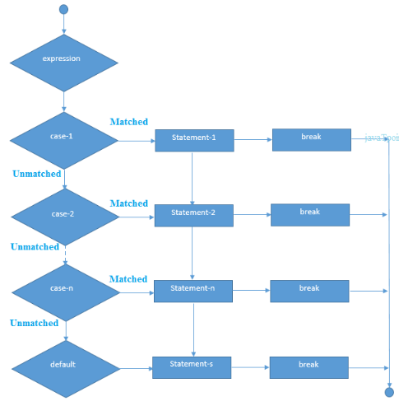
Switch Statement
Syntax:
  switch(expression){
    case value1:
      //code to be executed;
      break; //optional
    case value2:
      //code to be executed;
      break; //optional
    ......
    [default:
    //code to be executed if all cases are not matched;
    ]
  }

Slide 26
Switch Statement
public class SwitchMonthExample {
  public static void main(String[] args) {
    int month=7;
    String monthString="";
    switch(month){
      case 1: monthString="1 - January"; break;
      case 2: monthString="2 - February"; break;
      case 3: monthString="3 - March"; break;
      case 4: monthString="4 - April"; break;
      case 5: monthString="5 - May"; break;
      case 6: monthString="6 - June"; break;
      case 7: monthString="7 - July"; break;
      case 8: monthString="8 - August"; break;
      case 9: monthString="9 - September"; break;
      case 10: monthString="10 - October"; break;
      case 11: monthString="11 - November"; break;
      case 12: monthString="12 - December"; break;
      default:System.out.println("Invalid Month!");
    }
    System.out.println(monthString);
  }
}

Slide 27
Switch Statement
public class SwitchVowelExample {
  public static void main(String[] args) {
    char ch='O';
    switch(ch)
    {
    case 'a': System.out.println("Vowel"); break;
    case 'e': System.out.println("Vowel"); break;
    case 'i': System.out.println("Vowel"); break;
    case 'o': System.out.println("Vowel"); break;
    case 'u': System.out.println("Vowel"); break;
    case 'A': System.out.println("Vowel"); break;
    case 'E': System.out.println("Vowel"); break;
    case 'I': System.out.println("Vowel"); break;
    case 'O': System.out.println("Vowel"); break;
    case 'U': System.out.println("Vowel"); break;
    default: System.out.println("Consonant");
    }
  }
}

Slide 28
References
https://www.javatpoint.com/operators-in-java
https://www.tutorialspoint.com/java/java_basic_operators.htm
https://www.journaldev.com/29007/type-casting-in-java
https://www.geeksforgeeks.org/type-conversion-java-examples/
https://syntaxdb.com/ref/java/type-cast
https://www.javatpoint.com/java-if-else
https://www.javatpoint.com/java-switch
https://www.w3schools.com/java/java_switch.asp
https://beginnersbook.com/2017/08/java-switch-case/
https://beginnersbook.com/2017/08/java-switch-case/

Slide 29


